Slide 1

Science for Sustainable Oceans
Working Group 39
Global trends in pollution of coastal ecosystems
Leading Agency: IAEA
Mr. Hartmut Nies
IAEA Marine Environment Laboratories
Co-sponsoring Agency: UNIDO
Mr. Ludovic A. BERNAUDAT
Environmental Management Branch
39th GESAMP meeting, New York, 15-20 April, 2012

Slide 2
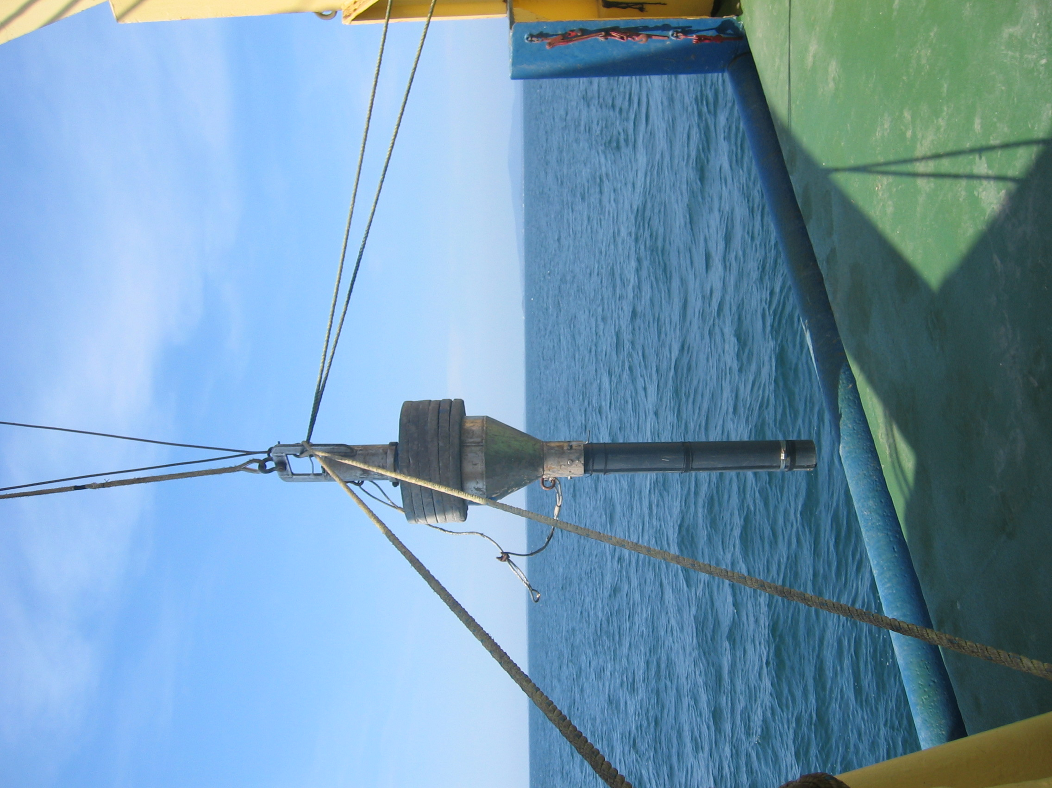
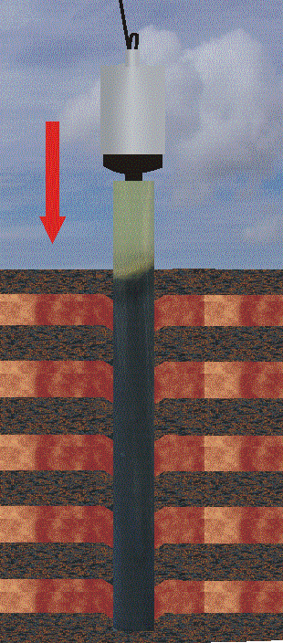
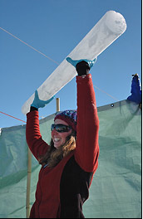
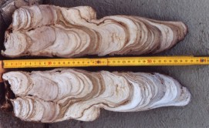

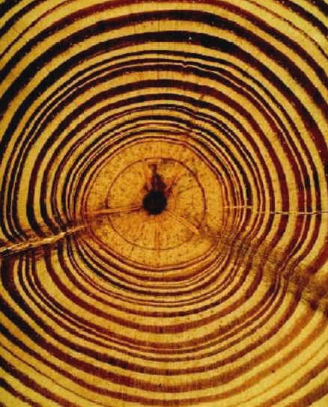
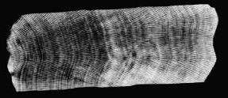
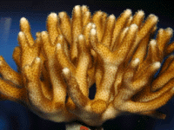
Long term environmental monitoring data are scarce, limited over time and geographically sparse
Sedimentary layers
Reliable temporal frame
Notes:
La buena noticia es que el impacto antrópico queda registrado por la naturaleza misma en archivos ambientales como los núcleos de hielo, espeleotemas, los anillos de los árboles, corales y conchas, así como los sedimentos de lagos y mares. Dado que los sedimentos integran la mayoría de las señales causadas por el CG en los ecosistemas, los nucleos sedimentarios no perturbados son el archivo preferido por los científicos y usualmente son la única manera de establecer series de tiempo ambientales de largo plazo para el estudio de las tendencias del CG, lo que requiere del establecimiento de un marco temporal confiable

Slide 3
²¹⁰Pb and ¹³⁷Cs are the most accepted radiometric methods to date recent sediments
Reconstruction of environmental conditions in the past and quantify the observed changes
Suitable to reconstruct environmental changes during the last 100 years, period in which GC manifestations are more evident

Slide 4
If we could recover an undisturbed sediment sample and there is a reliable temporal frame, it is posible to reconstruct the environmental conditions that prevailed at the moment when the sediments settled.
Superposition principle

Slide 5
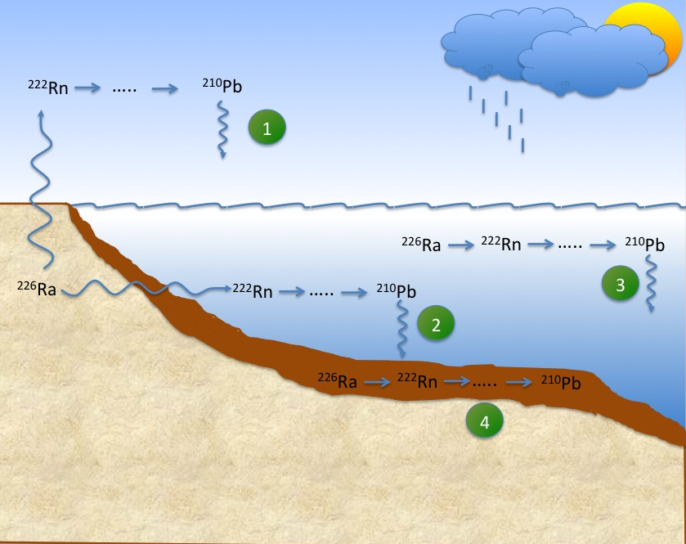
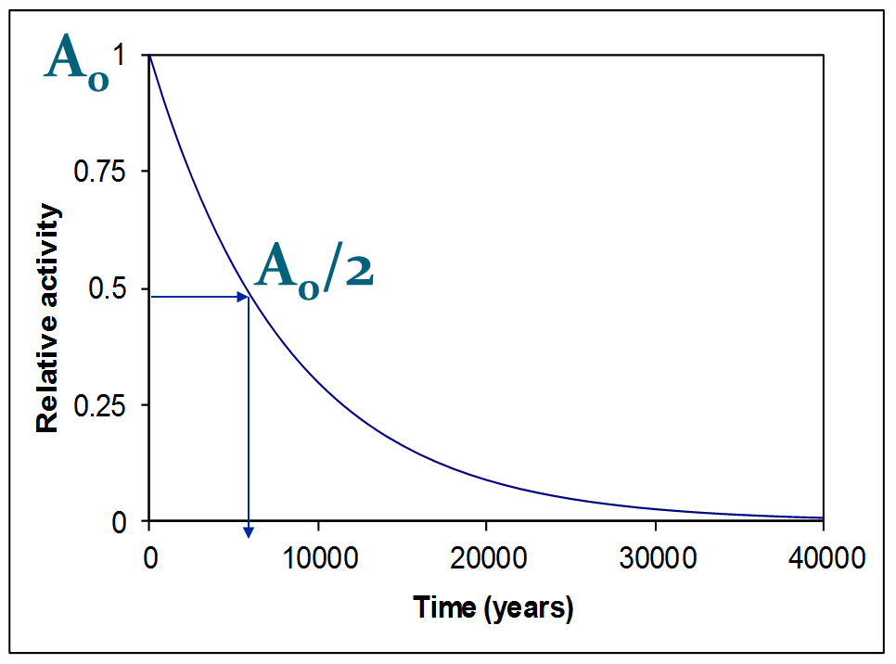
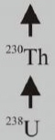
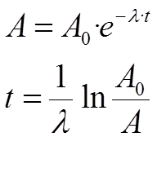
²¹⁰Pb geochemical cycle

Slide 6
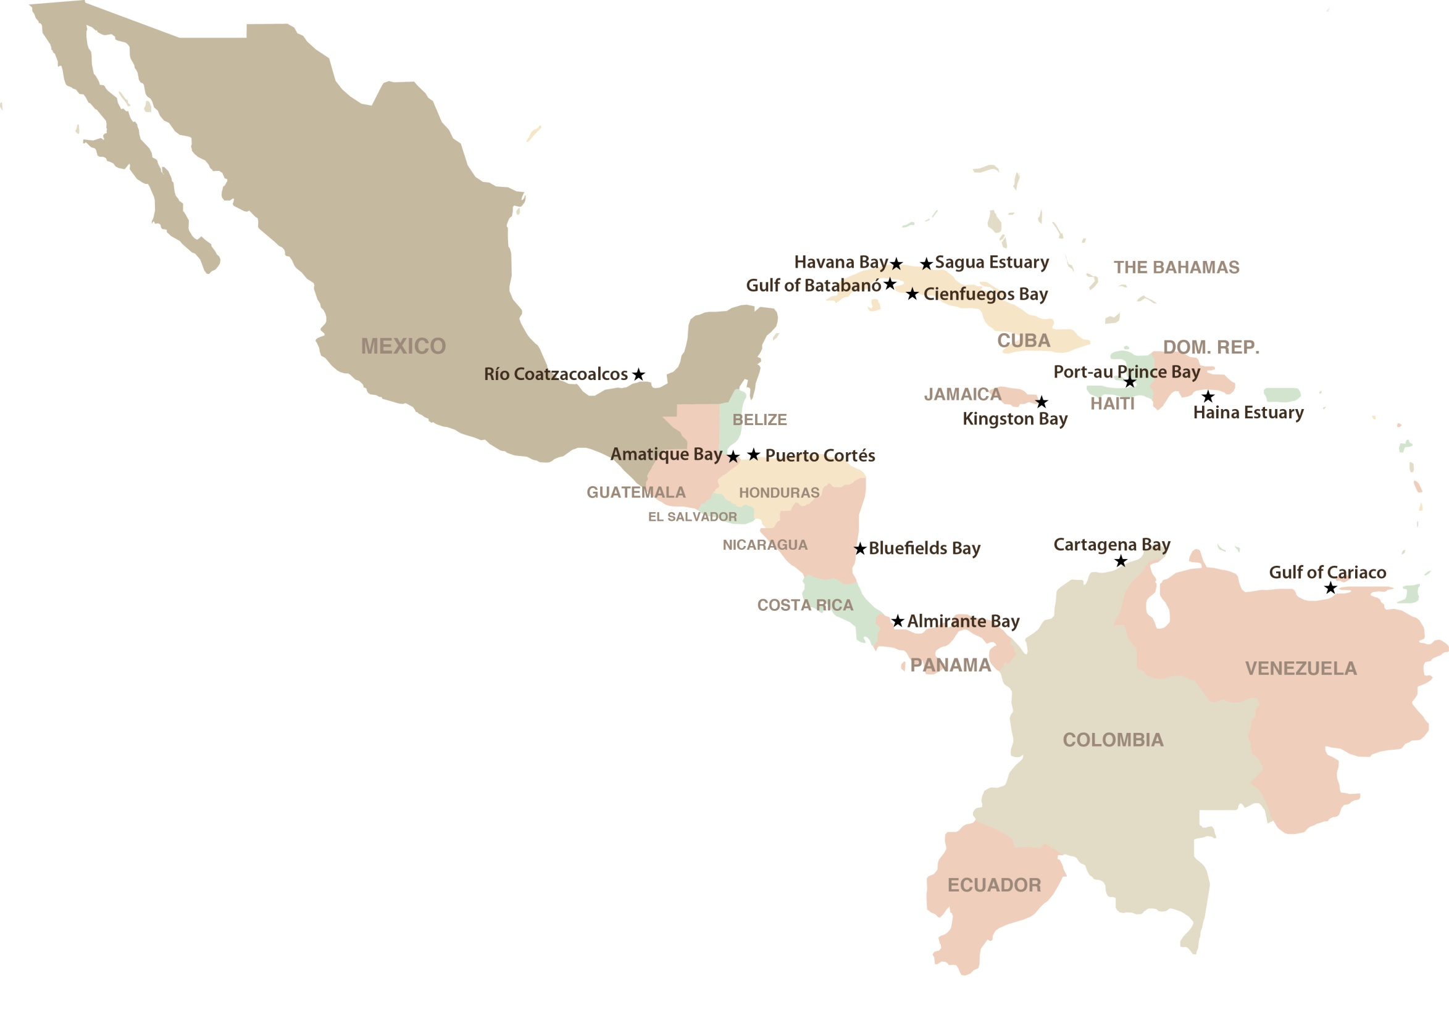
Use of Nuclear Techniques to Address the Management Problems of Coastal Zones in the Wider Caribbean Region
INTERNATIONAL ATOMIC ENERGY AGENCY
Technical cooperation project RLA7012
“To develop and improve capabilities to reduce the degradation, due to anthropogenic and natural impacts, of the coastal ecosystems of the wider Caribbean region”

Slide 7
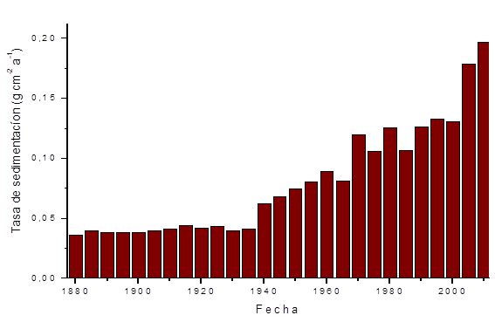
Sedimentation in Amatique Bay, Guatemala
Landbased sources of pollution, Land Use Changes/erosión

Slide 8
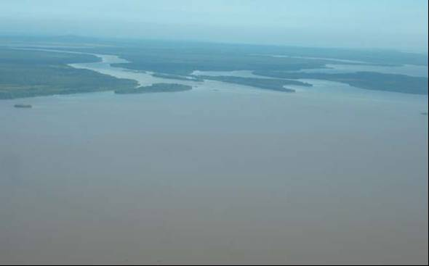
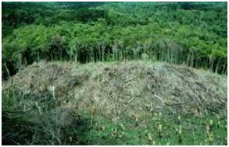
Sediment accumulation rates

Slide 9
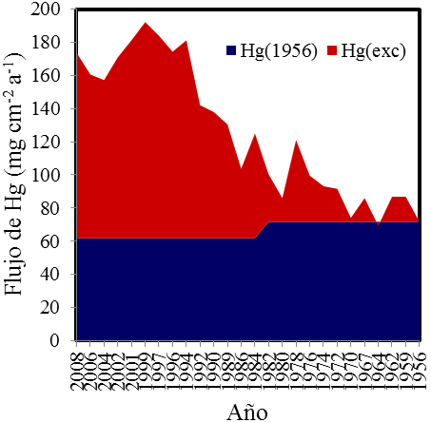
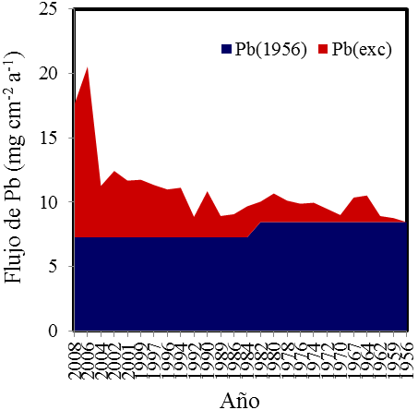
Trace metals contamination, continental shelf off the mouth of Coatzacoalcos River
Ruiz-Fernández et al., Continental Shelf Research, 2012

Slide 10
Flux of metals in Havana Bay, Cuba
Díaz-Asencio et al., Hazardous Materials, 2011
Notes:
We have calculated the natural and anthropogenic metal fluxes to sediments as indicated in the equation.
It is evident that the anthropogenic lead flux increases rapidly until the 1990s and then decreases to values similar to the anthropgenic flux in the 1930s.
We observe a similar pattern for zinc, sulfur, tin and mercury. Fluxes in Havana bay have been reduced for all of them.
This is due to the control of contamination sources and the reduction of total suspended matter supply in the bay and shows the effectivenes of the coastal management actions taken by the cuban government by the end of the 1990s.

Slide 11
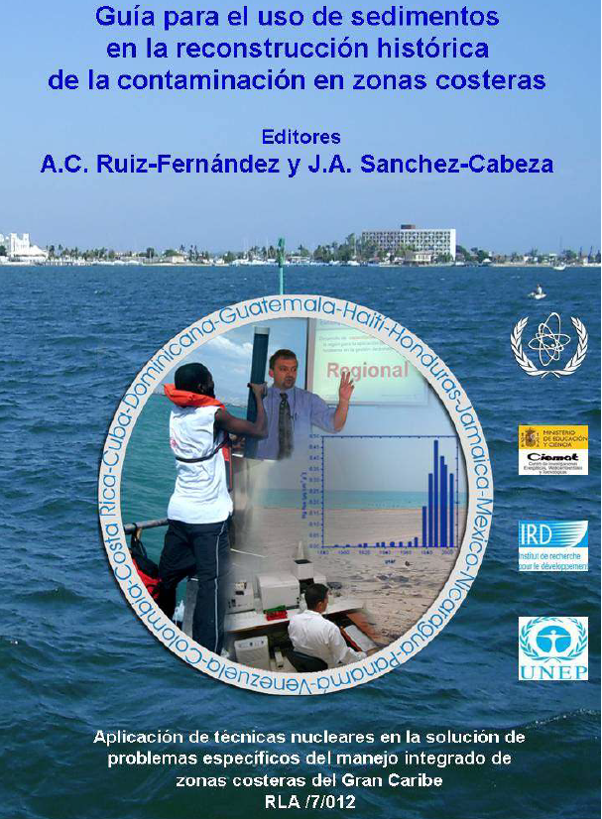
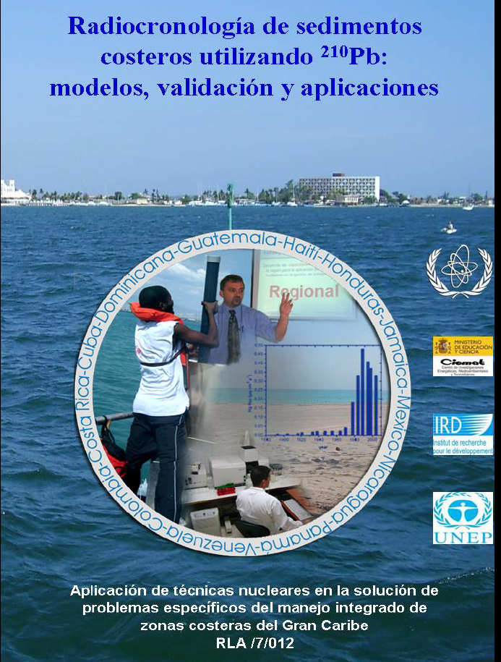


Slide 12
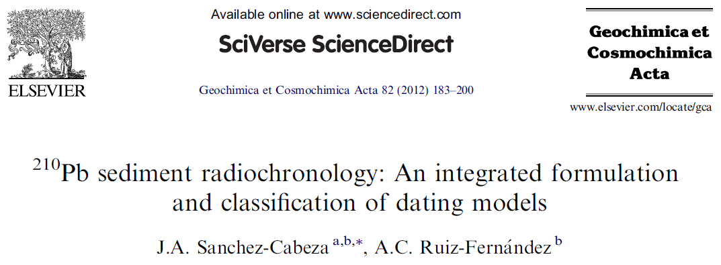

Special Issue “Environmental Records of Anthropogenic Impacts"
From Krishnaswamy et al ., 1971

Slide 13
Working Group 39
Global trends in pollution of coastal ecosystems
Leading Agency: IAEA
Mr. Jae R. OH
IAEA Marine Environment Laboratories
Co-sponsoring Agency: UNIDO
Mr. Ludovic A. BERNAUDAT
Environmental Management Branch
39th GESAMP meeting, New York, 15-20 April, 2012

Slide 14
Background
A global assessment of pollution trends during the last century in sensitive coastal ecosystems, through retrospective ecosystem analysis, by using dated environmental archives and time-series data where available.
Trends and patterns on pollutant concentration, fluxes and inventories will be defined using the wealth of knowledge of radio-chronology in coastal marine sediments (e.g. ²¹⁰Pb, ¹³⁷Cs)
UN Regulators will have a predictive knowledge and a management argument tool on the evolution of contaminants in sediments around the world to link them with socioeconomic decisions at local and regional scales.

Slide 15
Main tasks of WG39
Revise existing methodologies on suitable environmental archives, dating methods, pollution indicators, analytical techniques and trend analysis. Sedimentary environments not deeper than 200 meters would be considered in the analysis, thus including all the ocean borderlands as well as main Islands.
Review existing data, including data quality, on a regional basis. Records of pollution in coastal environments will be used as background information.
Design, implement and maintain, with the help of the leading organization, a database of global trends of pollution.
Disseminate the Working Group activities through the GESAMP website, press releases, preparation of educational materials and presentation at stakeholder meetings. Publish results in scientific journals. International Conference.
Report to GESAMP on all Working Group activities once per year.

Slide 16
TASKS
From the 37th session of GESAMP (Bangkok, 15-19 February 2010) ToR 1 and 2 are already approved by GESAMP but points 3 to 5 are pending the approval of financing from the UN agencies involved.

Slide 17
First meeting of Working Group 39
3-5 April, 2011 at Environment Laboratories, IAEA, Monaco
Mr. Fernando P. CARVALHO
Ms Ana Carolina RUIZ-FERNANDEZ
Mr Porfirio ALVAREZ-TORRES
Mr Duc Nhan DANG
Mr Elvis NYARKO
Mr Jae OH
Mr Joan-Albert SAnchez-Cabeza
Mr. Manmohan SARIN
Mr José L. Sericano
Ms Elvira SOMBRITO
Mr. Norbert THEOBALD
Ms Angela WAGENER
1. Definition of regions for WG39
The WG39 tasks were divided by region according to LMEs and these regions were distributed among the group members.

Slide 19
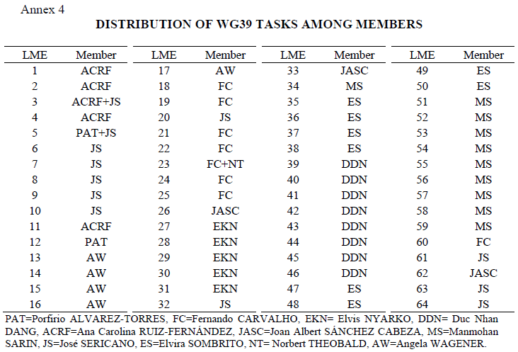

Slide 20
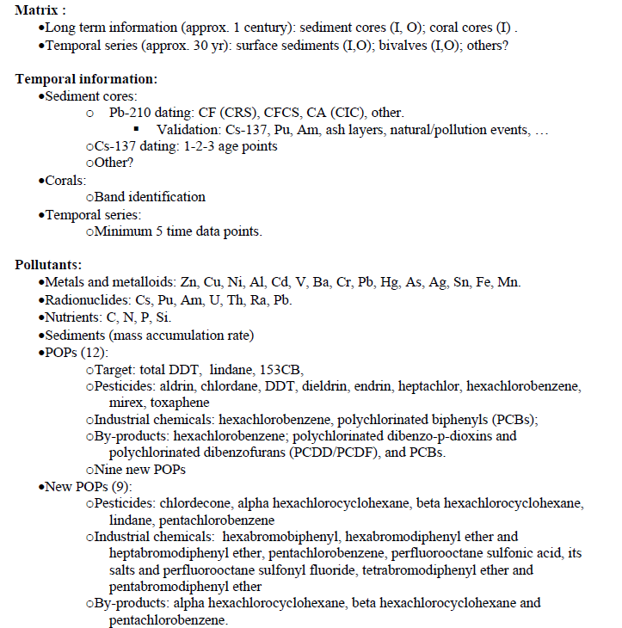
METHODOLOGY

Slide 21
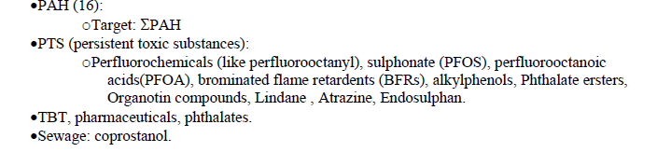
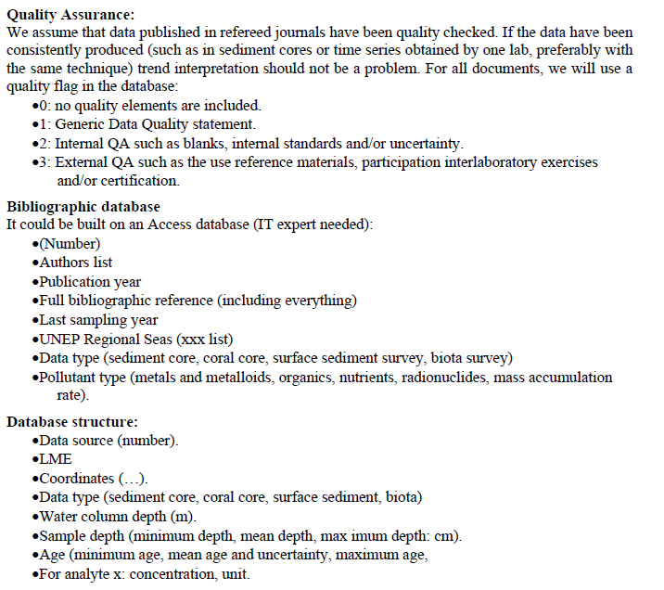
METHODOLOGY

Slide 22
Bibliographic data base
The initial design of the database, including the substrates, pollutants and other types of information (GESAMP 38/5/4) was developed in during the meeting and will be tested within one month after release to the WG39 members.
INTERSESSION ACTIVITIES
A first version of the bibliographic data base was created with the support of an IT from MEL during the meeting. A improved version has to be diseminated among the WG39 members, together with instructions, and shall be tested within one month after release.
The WG39 will start gathering and classifying scientific literature to be introduced in the bibliographic data base until a person is assigned to work on the compilation of data.

Slide 23
REQUEST EXPRESSED BY THE MEMBERS
Support for technician work (capture of information and database management)
Software license
Access to scientific data bases for information research
CURRENT STATUS
The database was initially created in Access but not all participants have this software available/Performance problems due to differences in software versions.
The current data base was developed in MSExcel format and it is already functional and being used by some WG39 members through DropBox.

